Slide 1
Movie Recommendation System
Group 7
Final Presentation by: Aarushi Mundra (A0246207J)
Dylan Wo Qiying (A0233634J)
Kaavya Senthil Kumar (A0246227E)
Kenny Low Sheng Wei (A0233869N)
Ng Wei Han (A0234338E)
Tasneem Benazir (A0238339W)
Notes:
Good afternoon Prof and TAs, we’re grp 7 and these are my grpmates and we are doing movie recommendation systems

Slide 2
Table of contents
01
02
03
04
05
06
07
08
09
Data Overview
Data Preprocessing
Demographic Filtering
Content Based Filtering
Convolutional Neural Network
Collaborative Filtering
Hybrid Recommender
Our Contributions
Proposal Review
Notes:
These are the table of contents that we will cover

Slide 3
01
Data Overview
Notes:
So ill start off with data overview

Slide 4
Data Overview
The MovieLens Dataset
Consists of the following files:
movies_metadata.csv: Metadata for 45,000 movies
keywords.csv: Movie plot keywords
credits.csv: Cast and crew Information
ratings_small.csv: Subset of 100,000 ratings from 700 users on 9,000 movies.
links_small.csv: IMDB and TMDB IDs of all movies featured in the ratings_small.csv
Notes:
We used the movielens dataset which consists of these following files

Slide 5
02
Data Preprocessing
Notes:
Next ill talk about our preprocessing

Slide 6
Data Preprocessing
Main Highlights
Removed invalid data for all dataset
Removed duplicate data for all dataset except ratings_small.csv
Trimmed movies_metadata.csv, credits.csv and keywords.csv to only include movies in ratings_small.csv
Notes:
There are no duplicate data for ratings_small as even though the composite key will be userId and movieId, the same user might re-rate the movie at a later time.
Because the models that are trained on the user’s ratings will only be exposed to the metadata, credits and keywords for the movies in ratings_small, the rest of the other movies will be considered obsolete. We decided to standardise this across all models.

Slide 7
03
Demographic Filtering
Notes:
Now ill talk about demographic filtering

Slide 8
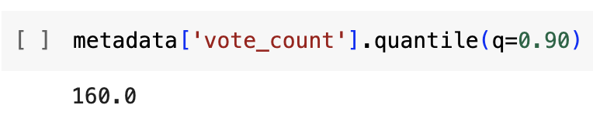
Demographic Filtering
1. Find a value for the minimum number of votes required for a movie to be listed in the recommendations. We used the 90th percentile as our cutoff
This means that for a movie to be in our recommendations, it needs to have at least 160 user ratings

Slide 9
Demographic Filtering
2. Calculate the weighted score for each qualified movie.
The formula we use is: Weighted Rating (WR) = ((𝑣/𝑣+𝑚)𝑅)+((𝑚/𝑣+𝑚)𝐶) where,
v: the number of votes for the movie
m: the minimum votes required to be listed in the chart
R: the average rating of the movie
C: the mean vote across the whole report
This is the Bayesian Average Formula, which we saw from the e-commerce project and decided to use it in ours
Intuition: Penalises movies below the threshold and the mean

Slide 10
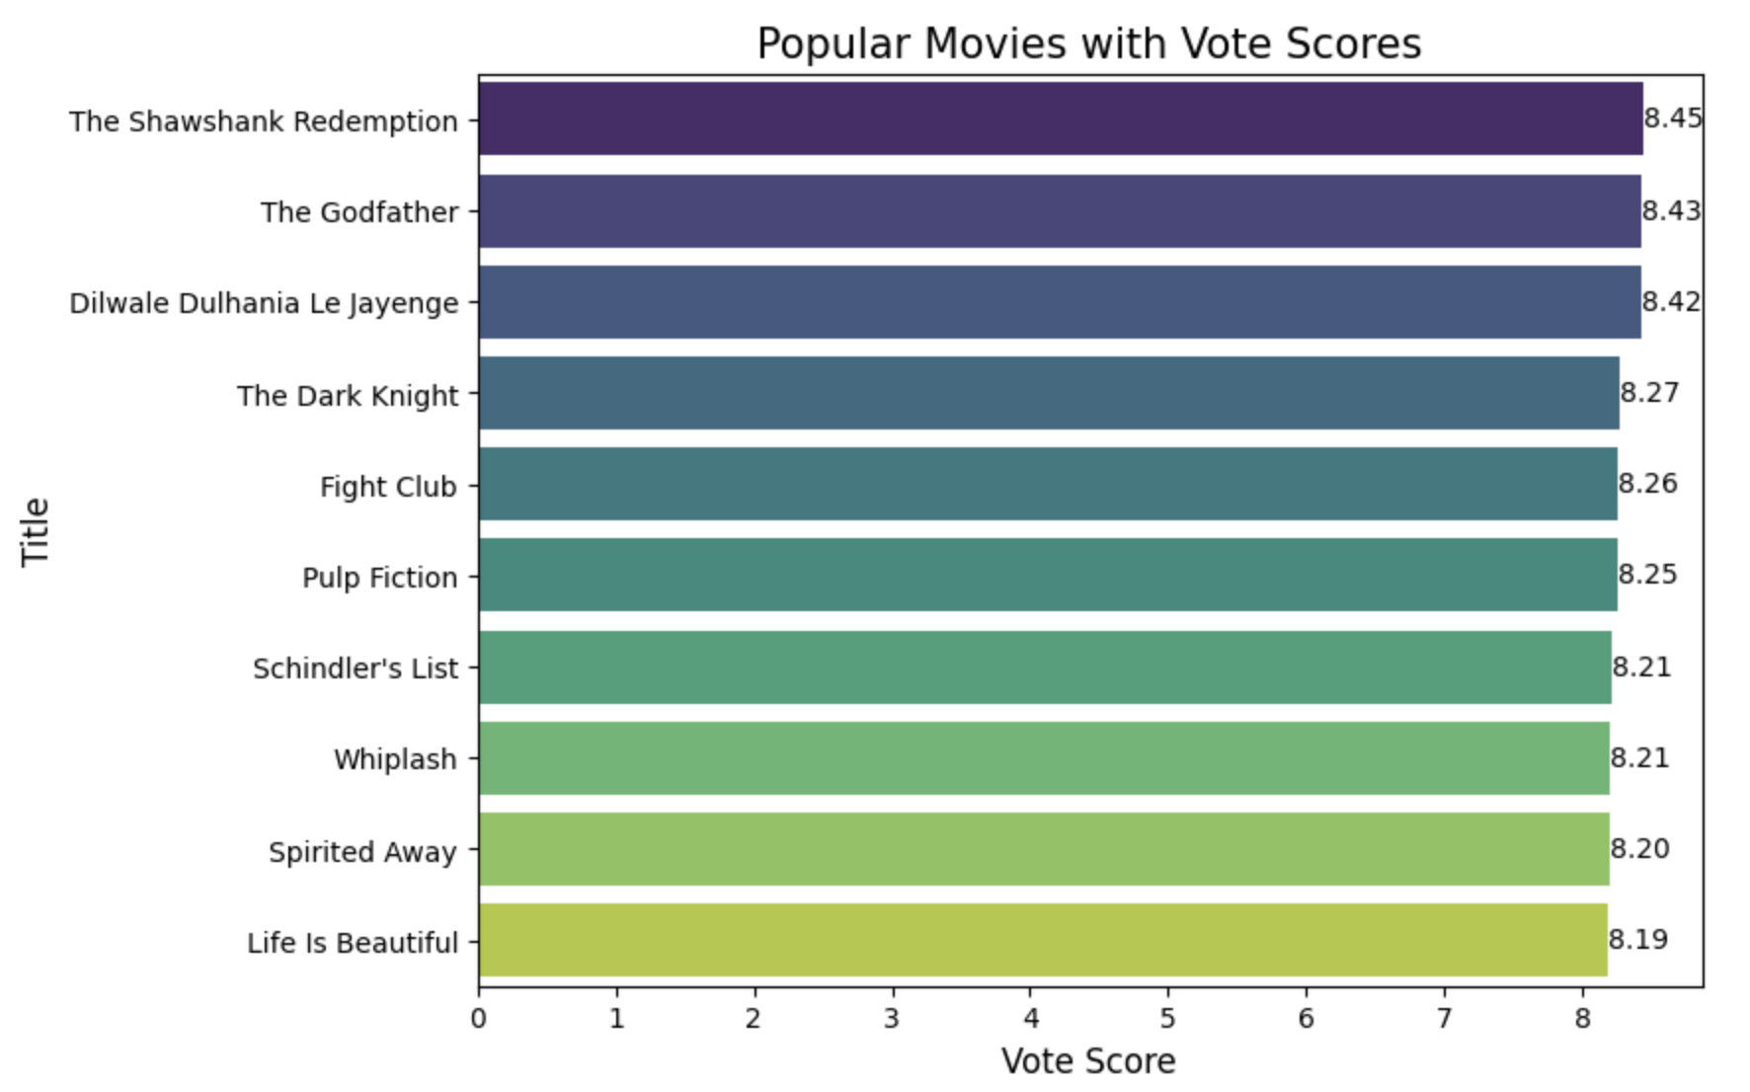
Demographic Filtering
3. Sort the weighted scores of all qualified movies in a descending order and output the top 10 movies.

Slide 11
Demographic Filtering
The Good
The Bad
Resolves the cold start problem for new users without a watch history
Not comprehensive as it does not take user sentiments into account

Slide 12
04
Content-Based
Filtering

Slide 13
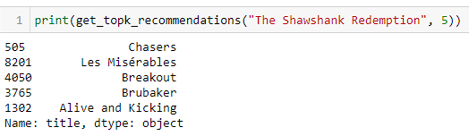
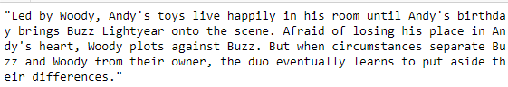
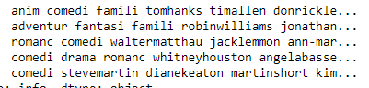
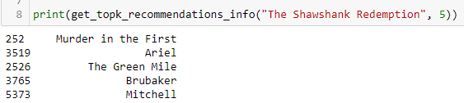
Basic Content-Based
Recommender
TF-IDF + Cosine Sim
Movie Description = Overview, Taglines
Count Vec + Cosine Sim
Movie Information = Genres, Keywords etc.

Slide 14

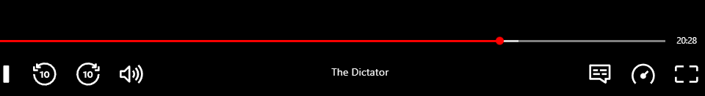

Pick Movie
Watch Movie
Based on duration,
Decide Like / Dislike

Slide 15
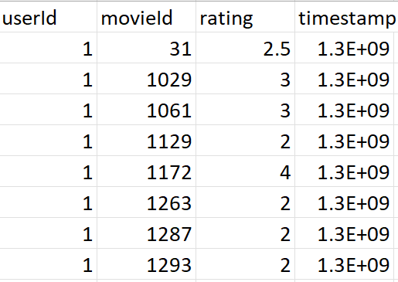
User Rating Data
But we don't have this data !

Slide 16


Next Best Option
Time
Recommend Movie
Pick Movie
Rate Movie
Based on Rating,
Decide LIke/ Dislike

Slide 17
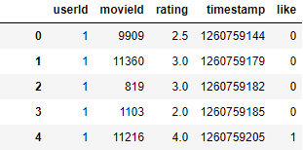
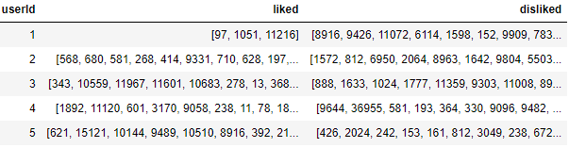
Evaluation
Like Movie >= 4.0 Rating
Mean Rating ~ 3.5

Slide 18
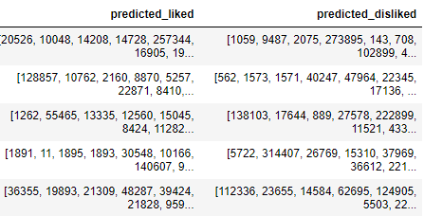
Evaluation

Slide 19
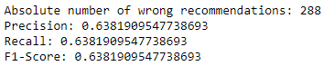
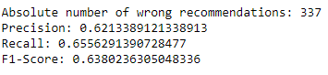
Evaluation
Movie Description CBF
Movie Information CBF

Slide 20
Evaluation
Movie Description CBF
Movie Information CBF
Let’s Combine Them !

Slide 21
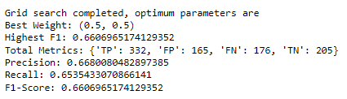
Evaluation
Optimal CBF Model uses 50% of each individual model’s cosine similarity

Slide 22
05
CNN

Slide 23
Thought Process
Analyze and Compare Visual Features
Color Palettes
Viewers enjoy movies with similar thematic tones
Converted the movie posters into numerical vectors
Cosine Similarity to find similarity
After CNN

Slide 24




Posters showcase

Slide 25
06
Collaborative
Filtering

Slide 26
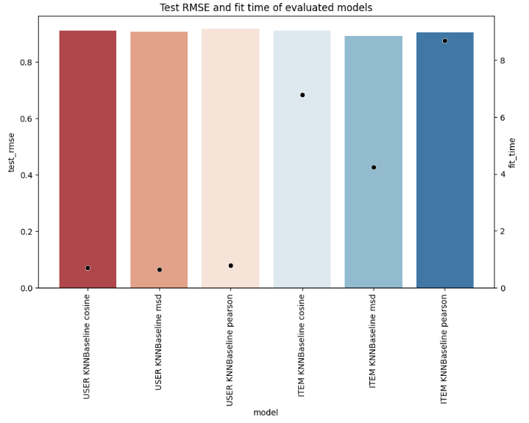
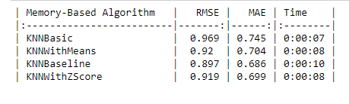
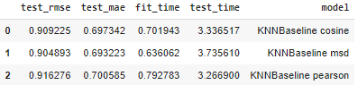
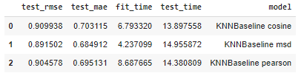
Memory-Based
User Based
Item-Based Pearson Similarity KNNBaseline
Hyperparameter obtained by GridSearch is:
k = 50, (the max number of neighbours to take into consideration in aggregation)
min_k = 5, (the minimum number of neighbors to take into account for aggregation)
min_support = 5 (minimum number of common items needed between items)
Item Based
Pearson correlation inherently normalizes the rating scales by considering the deviation from the mean rating of each user.
Notes:
For the memory based, we identified that Item based pearson similarity knnbaseline has the best performance, with these following hyperparameter. We can see in the bar chart above that the models have the same fitting time, but Item based pearson model has the highest

Slide 27
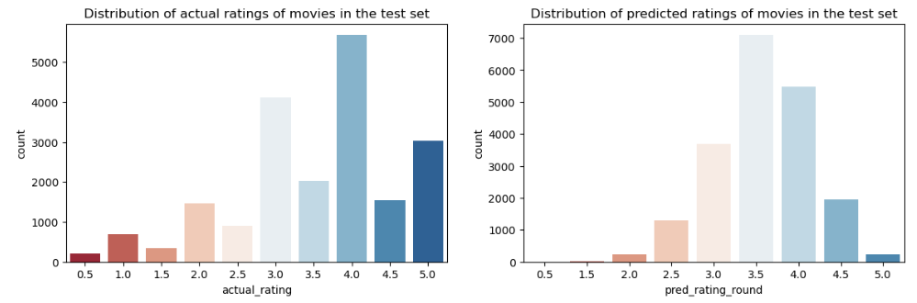
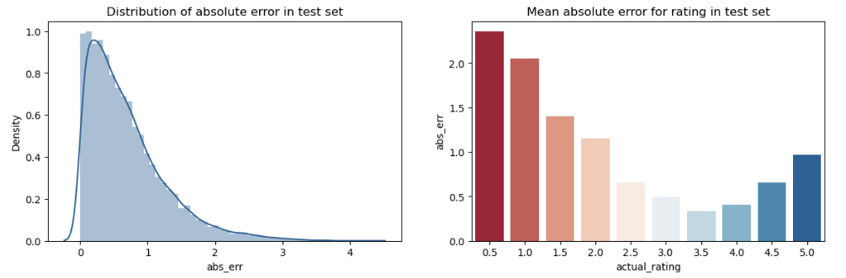
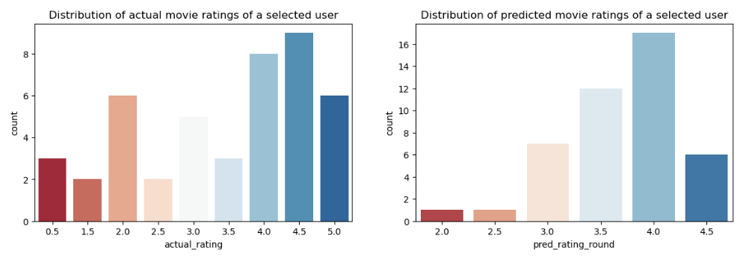
Memory-Based Evaluation
Have issues predicting 5.0
Notes:
Upon evaluation, we identify that the model have issues predicting ratings of 5.0, as show in the barchart of predicted ratings in the top left.

Slide 28
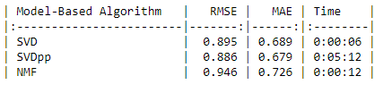
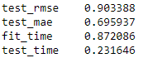
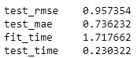
Model-Based
SVD
SVD
Hyperparameter obtained by GridSearch is:
N_factors = 80 (the number of factors)
n_epochs = 20 (the number of iteration of the SGD procedure)
lr_all = 0.005 the learning rate for all parameters)
reg_all = 0.2 (the regularization term for all parameters)
NMF

Slide 29
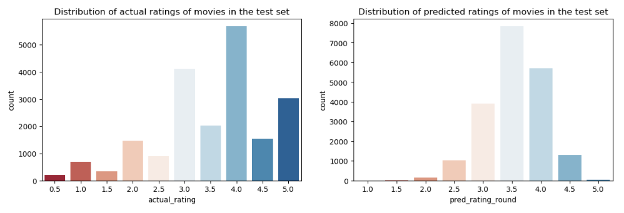
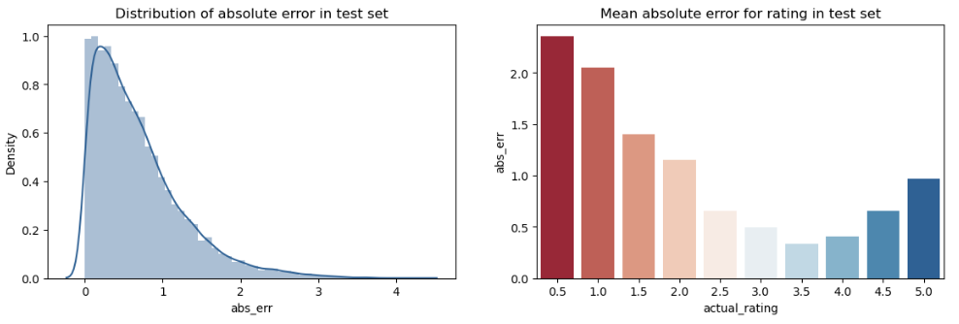
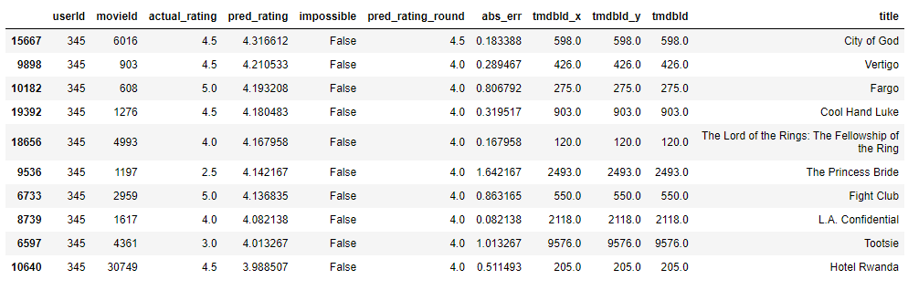
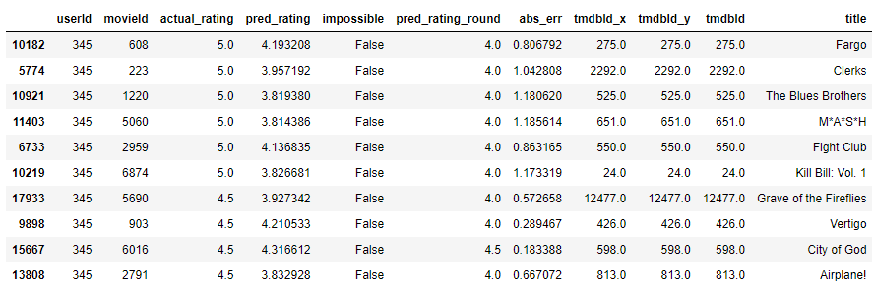
Model-Based Evaluation
Predicted 4/10 in the actual top 10
Have issues predicting 5.0
Predicted
Actual

Slide 30
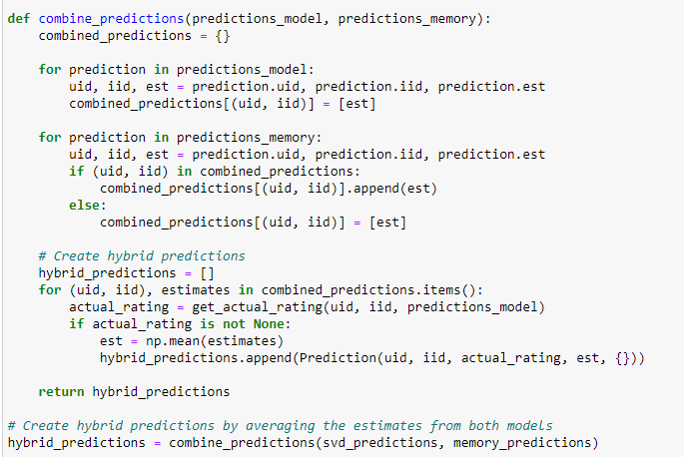
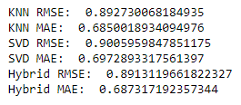
Model-Memory Hybrid
Take average of both prediction estimates

Slide 31
07
Hybrid Recommender

Slide 32
Calculating a basis for the hybrid recommender
Why?
CBF: Limited in recommending items outside a user's known preferences.
CF: Struggles with cold start problems for new users or new movies which do not have enough ratings and suffers from sparsity issues.
Demographic Model: Does not take into account user sentiments

Slide 33
Calculating a basis for the hybrid recommender
How?
First, we calculate a threshold for the number of ratings a movie must have in order to determine which recommendation system it should run under.
For movies with number of ratings above a certain threshold, we use CBF and CF whereas for the movies with ratings lower than that threshold, we use CB only.

Slide 34
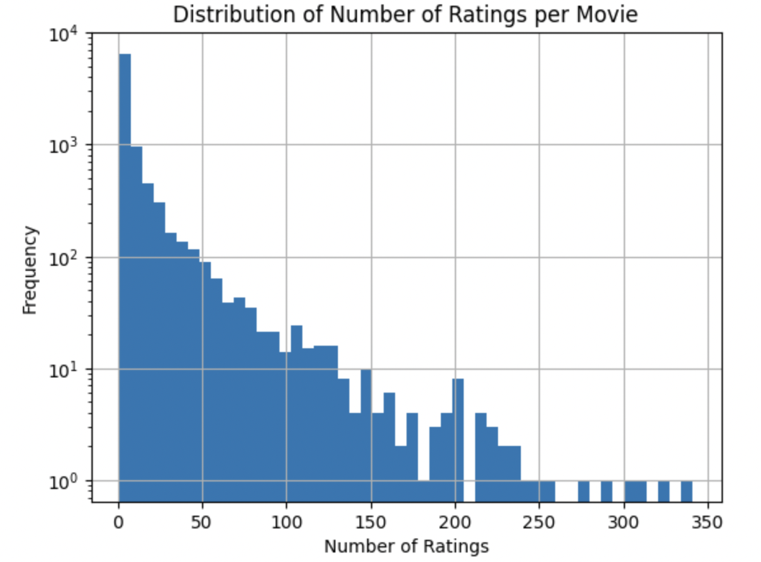
Determining the Threshold
03
If recommendation is asked for a movie that lies within the top 10% based on number of rating, we use CBF + CF
01
02
04
If the movie has number of ratings lower than the the threshold, we only used CBF
Calculate the 90th percentile of ratings
Create a list of movies in the top 10% based on the number of ratings

Slide 35
08
Proposal Review

Slide 36
Proposed Ideas
Contribution | Exceeds Expectations | Satisfactory | Under Expectations | Not Achieved
Hyperparameter tuning (Model-Based CF)
CF using kNN
Bayesian Average in Demographic Filtering
Hybrid RS
Re-ranking Models

Slide 37
09
Summary of our Contributions

Slide 38
Summary of Contributions
New Dataset
For CNN
Creativity in Feature Engineering
Used movie posters to create a new dataset.
The features of the dataset refer to the pixels in the poster
These features were used to create recommendations
Combined genres, actors, directors for CBF
Bayesian Average
Liked and Disliked creation and chronological ordering

Slide 39
Summary of Contributions
Evaluating Prediction Results of CBF
Hybrid
Threshold
Created 2 new evaluation metrics
Precision, Recall, F1-score
RMSE
Compared different CBFs using those metrics
Created a threshold to resolve the cold-start problem for movies.
Lesser rated movies will be given recommendations based on CBF.

Slide 40
Thanks!

Slide 41
